Slide 1



National TPP Team Conference Call June 29, 2014 - 4:30-6:00 p.m. PDT Selling Democracy: A Trade Talk with Rep. Jim McGovern Call-in #: 559-726-1300 Access code: 951146# Back-up #’s: 951-262-7373 or 805-360-1075

Slide 2
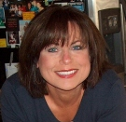
WELCOME! Call Facilitator: Elizabeth Warren MoveOn Regional Organizer National TPP Team Coordinator Email questions: Liz.MoveOn@earthlink.net • Call structure and norms • Meeting room functions Download the PowerPoint Options: NEW PDA LOCATION: http://http://www.pdacommunity.org Global TPP Team Facebook Page: http://on.fb.me/O76Pxm

Slide 3
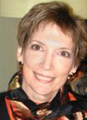
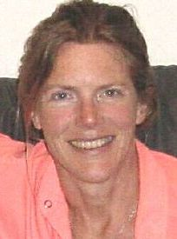
Post-meeting report+ Jan Swartzendruber Post-Call Report (off this week) MoveOn Regional Organizer KS JanInKansas2@gmail.com Liz Amsden National TPP Team Co-Organizer MoveOn Council Organizer CA Call Notes/Weekly Updates LizAmsden@hotmail.com Send info & links to: janinkansas2@gmail.com

Slide 4
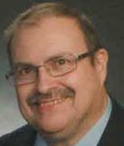
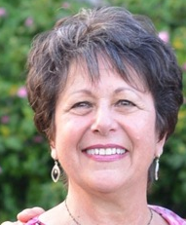
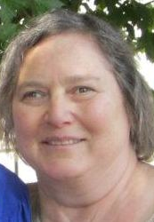
Your meeting host team: Tom Hocking – FB Global TPP Page National TPP Team Data Manager MoveOn Regional Organizer, PA TWHocking@gmail.com Lisa Oldendorp – In-call questions MoveOn Regional Organizer, NY National TPP Team Chat Manager
Mara Cohen – Notes /Chat Host
TPP Team Organizer, IL
National TPP Team Chat Host MCMoveOn@gmail.com
eslsk8r@optonline.net

Slide 5
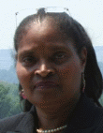
Andrea Miller, PDA Co-Executive Director Contact: andrea@pdamerica.org Campaign Update: “Countdown to Coverage” This week, tell Congress: No Fast Track! Protect “Buy American” Click here to get started: http://bit.ly/IO9hXO www.pdamerica.org/tpp

Slide 6

COUNTDOWN TO COVERAGE Fight the TPP Propaganda! Content Constantly Updated! Copy and paste the link below into your browser to write and send a “letter to the editor” to your newspaper demanding they cover TPP! Choose from pre-written content, or compose your own and click to send: http://bit.ly/IO9hXO Send us a link to your published letter so we can share it on the National Map: amiller6210@gmail.com

Slide 7
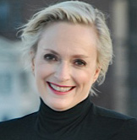
Emilianne Slaydon
Director, Social Media
@TPP Media March
TPP Tuesday Twitter Storms
6 p.m. PDT / 9 p.m. EDT
Contact: eslaydon@mac.com
TPP/TTIP Tuesday Tweets
for July 1:
http://bit.ly/1cLBYlQ

Slide 8


Slide 9
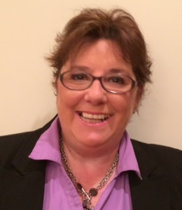
Kian Frederick National Field Director Public Citizen’s Global Trade Watch This July 4th week: * Still all about Fast Track * Capital Hill Update * July 4th "Buy American" Campaign
* Get August Recess appt NOW
Website: http://www.tradewatch.org
TPP Resources: http://www.exposethetpp.org
Facebook: www.facebook.com/GlobalTradeWatch
Our blog: http://www.EyesOnTrade.org

Slide 10

“Shiny Objects” TISA =
TAFTA/TTIP = TTP = STOP FAST TRACK

Slide 11
What’s Sen. Wyden Up To? a. Was critical of Camp-Baucus b. New plan called “Smart Track” c. Plans to build “bipartisan, bicameral consensus” for his new bill d. Kicked off the campaign with first hearings this week—more to come e. New bill likely--after the mid-terms

Slide 12
“Smart Track” can’t be Fast Track in disguise! A. Fast Track Fundamentals: i. President can sign trade deal before Congress sees it ii. No amendments or changes iii. Limited debate – only 60 days to pass it B. We don’t know what it is yet, so can’t oppose C. Congress won’t listen if we don’t appear flexible D. Currently in lobby mode on the Hill. Need same
ACTION in Districts.

Slide 13
WE BEAT BACK CAMP-BAUCUS. WE WILL WIN AGAIN THE SAME WAY: A. Lobby on the Hill and ACTION in the districts B. August recess: Call and get a meeting NOW:! C. July 4th “Buy American” campaign: i. Government Procurement Chapter of TPP would ban “Buy American” laws and “Buy Local” rules Ii. Plan bird-dogging, leaflet parades, rallies at district offices, honk & wave events, etc. TAKE PICS/VIDEO!! Send to Kian. iii. Sign up on members’ websites: -- Official: .gov site (constituents and locals only) -- Campaign: .com site: Search “[name] for Congress” (or “for U.S. Senate”);

Slide 14
Plan your July 4 Week Bird-Dogging Events! Time a July 4 action to the Ottowa TPP talks! Post events TODAY! Paste this browser link to create your event: http://civic.moveon.org/event/events/create.html?action_id=276 Email event link to: kfrederick@citizen.org MESSAGE: “ PROTECT BUY AMERICAN
AND BUY LOCAL in ALL TRADE DEALS” August Recess: Schedule meetings now!
Stop Fast Track Action Plan
Summer Recess Strategy

Slide 15
Getting Media Coverage for Events; Reporting your Recess Meeting results A. Give us a heads’ up – we’ll help promote your event to media. Send all details in advance to: Kfrederick@citizen.org B. Find and contact your local MEDIA: For newspapers, use our letter tool - copy and paste the link below and enter your zip code: http://salsa3.salsalabs.com/o/1987/letter/?letter_KEY=1515 (ABC, CBS, NBC) Cut and paste THESE LINKS to find your local TV network news affiliates: http://site.abc.go.com/site/localstations.html http://www.cbsnews.com/news/cbs-tv-news- stations-and-affiliates/ http://www.nbc.com/local-stations C. AFTER YOUR MEETING: Tell us EXACTLY what your Senator or Representative says. Send photos! Public Citizen will post them on social media and share widely. kfrederick@citizen.org

Slide 16
NEW Public Citizen Recess Week
Activist Toolkit!
Goes LIVE Monday: www.exposethetpp.org Click on July 4th Actions link CONTENTS:
Flyer
Map (up Monday close of biz)
Bird-dogging questions

Slide 17


Slide 18

-Flyer – 2 sided PDF click to download -Map – Find your Reps - Bird-Dogging Questions – customize and personalize

Slide 19
Stop Fast Track: Why we can’t let up Ongoing Citizen Education: NEW Training Tools Coming Soon! Watch your Email for updates! How We’ll Win: Stay focused on House Members!

Slide 20
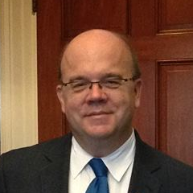
TRADE Q&A With Congressman Jim McGovern

Slide 21
Thanks to our Speakers! Upcoming Calls: Rep. Keith Ellison, D-MN – 7/06 Public Citizen: Teaching TPP 2.0 “Train the Trainer” w/Script! (TBA)

